Slide 1
An Approach to a Disaster Management Information System
By Mohammed Faisal Khan

Slide 2
Introduction
What is a Disaster management information system?

Slide 3
Why do we need a DMIS?
No time to think when a disaster happens.
01
A Disaster Management information System (DMIS) can be a useful tool during such time.
02
The Goal of this study is to present an approach to DMIS.
03

Slide 4
What is the scope of the information?
People have become a great source of data.
They share information on social media.
This data collected is huge.
Additionally, data is available from other sources like news websites, government plans, etc.
Data collection can happen during the 4 phases of disaster management; Mitigation, Preparedness, Response, and Recovery.
Delivery is focused during response phase.

Slide 5
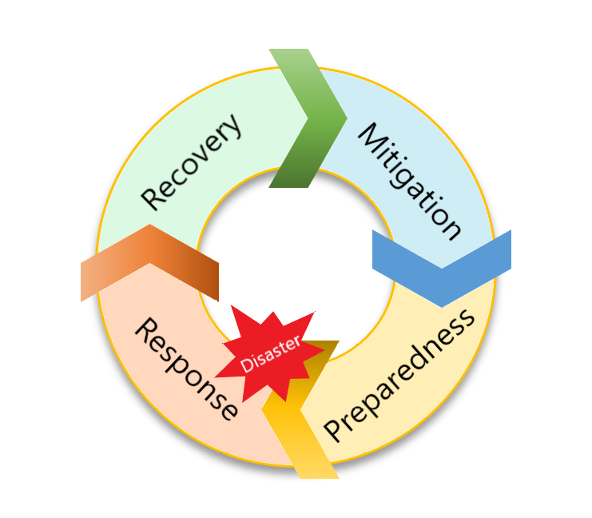
Phases of Disaster Management
What are the 4 phases of disaster management?
Mitigation, Preparedness, Response, Recovery
What are the 4 phases of disaster management?
Mitigation, Preparedness, Response, Recovery

Slide 6
Phases of Disaster Management
Mitigation: Involves steps to reduce impact of disaster.
Ex. Planning infrastructure
Preparedness: Concerned with formulation of plans and protocols.
Ex. Developing response mechanisms, procedures and strategies to follow. Setting up warning systems, shelters and storing food.
Response: Triggered when a catastrophe occurs. Deals with measures to save life and property, improve health and morale of affected population.
Ex. Providing safe zones and shelters, evacuation plans, extraction zones and protocols to follow.
Recovery: Aftermath of a disaster. Concerns with aiding the population to get back on their feet.
Ex. Repairing structures, resuming business, etc.

Slide 7
Technologies relevant to DMIS
Overview of high-level concepts

Slide 8
Big Data in DMIS
Traditional RDBMS were designed in an era without big data.
Big Data introduced a shift in how data is being produced and stored.
What is Big Data?
"Big Data" is a terminology used to define large sets of data that can be both structured and unstructured, as well as complex for traditional data processing techniques.
3 V’s of Big Data: Volume, Velocity and Variety.
Here, it refers to the large collections of disaster-related data sets being collected from various sources and disaster contributors.
Besides volumes, variety of disaster-related data is a problem.
Efficient use of collected information can improve decision making.

Slide 9
Cloud Computing in DMIS
NIST Defines cloud computing as:
"a model for enabling ubiquitous, convenient, on-demand network access to a shared pool of configurable computing resources (e.g., networks, servers, storage, applications, and services) that can be rapidly provisioned and released with minimal management effort or service provider interaction.“
Due to large amounts of data, cloud computing can provide resources to store and process it.
Added benefit of all the advantages of cloud computing.
Ex. High Availability, Scalability, Elasticity etc.
Also, Platform can start small and then grow (Scalability).
More importantly we need our platform to run during a disaster – HA and FT (Disasters can potentially cause failures, but cloud computing can help).

Slide 10
NoSQL in DMIS
RDBMS exhibits scalability issues.
NoSQL data stores satisfy cloud and big data requirements.
- Straightforward and flexible non-relational model.
- Ability to scale horizontally.
- High Availability.
- Schema normalization is not stressed.
- Eventual consistency.
- Resource intensive applications like joins are avoided.
Advantages of NoSQL make it an ideal choice for storing and managing disaster-related data.
Mainly classified into:
- Document stores, Key value stores, Column-family stores and Graph databases.

Slide 11
ML in DMIS
Proposed use of Context filtering or Recommender models to filter data to gather accurate information.
Recommends elements based on comparison between the content of the elements and requirement of the output.
They can also be used to verify sources.
There is a lot of potential use cases for a system like this, huge research going on.

Slide 12
Design and Implementation
Specific Technologies used

Slide 13
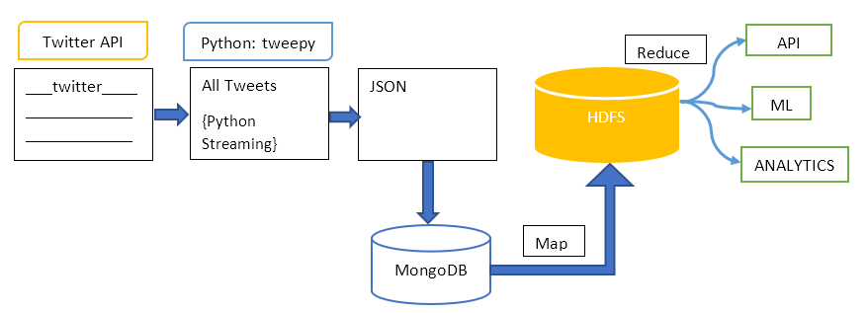
Platform Design
Twitter Streaming API provided by Twitter is incorporated in to the system by using tweepy, a python library, to extract the disaster related data.
The Streaming API provides a JSON output which is stored into MongoDB.
The output of the MongoDB is parsed using a cognitive filtering system to filter out the irrelevant data and then sent to Hadoop mapper to store all the relevant information in the HDFS data store.
Hadoop reduce is used to structure the relevant information and provide it to the end user.

Slide 14
Twitter and Twitter API
Data extraction: REST API, Search API, Streaming API
Twitter API call – Authenticate with OAuth, Make API call, Receive JSON, Interpret JSON
There are four keys Consumer Key, Consumer Secret Key, Access Token, and Secret Token.
Call Wrapper:
Words such as ’hurricane’, ’flood’, ’epidemic’, etc., can be listed to stream tweets containing these words.

Slide 15
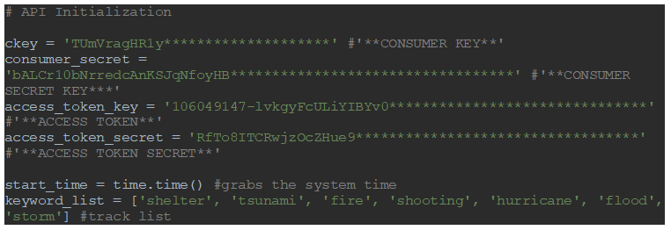
Setting Tokens
Tokens are generated using the Twitter application development platform.
Tokens abstract the Twitter authentication information form the end user.
OAuth is used to achieve this, this provides security to the twitter data store.

Slide 16
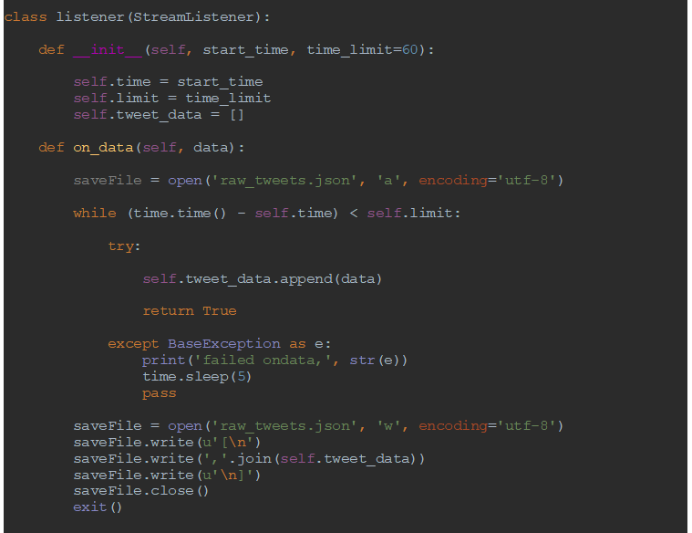
Tweepy Class Instance
The code shown does the following:
Creates an OAuthHandler instance to handle OAuth credentials.
Creates a listener instance with a start time and time limit parameters passed to it.
Creates a StreamListener instance with the OAuthHandler instance and the listener instance.

Slide 17
MongoDB
/
Mongo DB is a document store.
First, a MongoClient Instance is created.
Next, the database and the collection to be used is set, here it is ‘twitter_collection’.
Then data is inserted into the collection using .insert().
Finally, .find() is used to recall the data store objects, where python returns MongoDB cursor that can be iterated by putting it in a for loop.
Mongo Data Store contains unfiltered data which includes the relevant and irrelevant information.

Slide 18
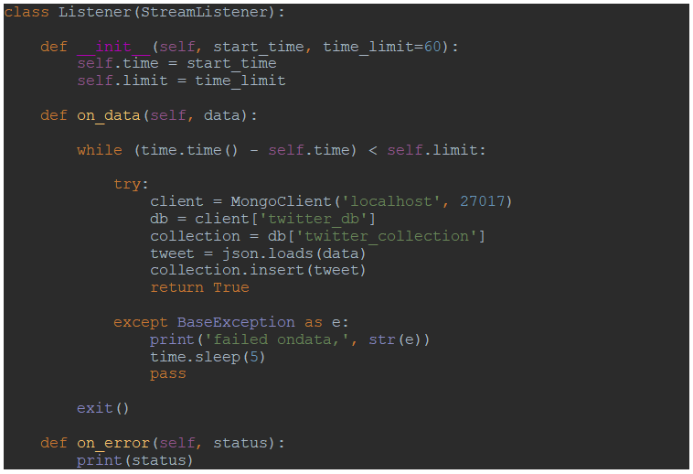
Running a Mongo Instance
The MongoClient is set to run on port ‘27017’
The data store is given as ‘twitter_db’
The collection is set as ‘twitter_collection’
All the tweets are collected and inserted into the collection

Slide 19
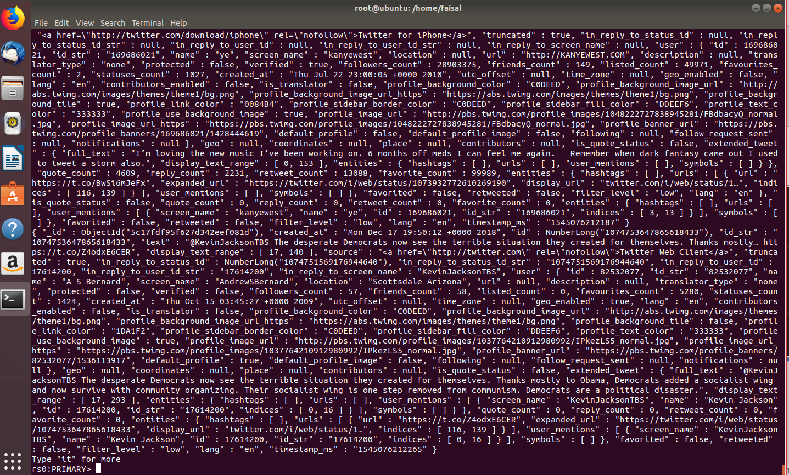
Stream result MongoDB
Continuous streaming through Twitter Streaming API
Mongo Instance continuously saves data into the data store
Real-time processing can happen

Slide 20
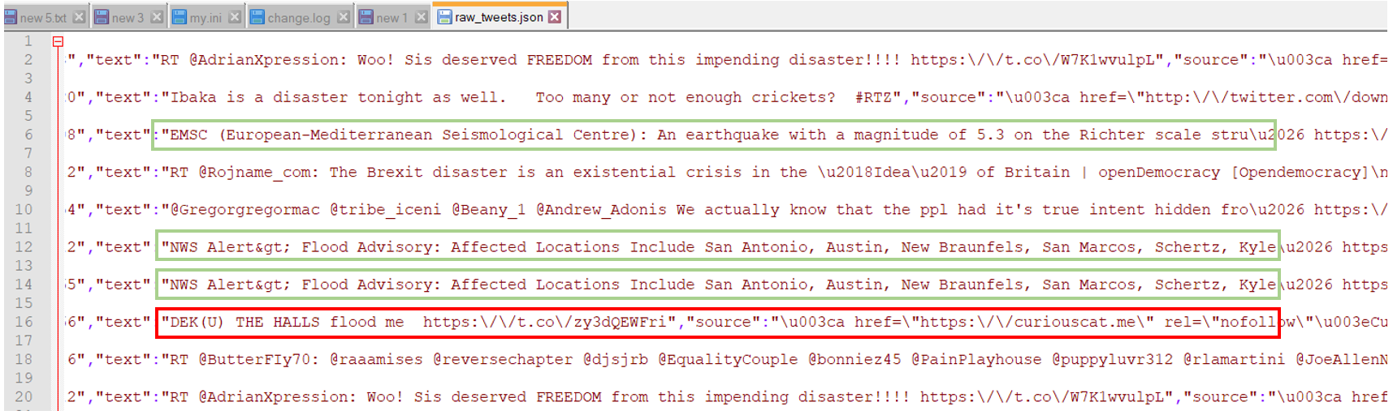
System Output
The keywords used are earthquake, disaster, flood.
The output is store to a flat .csv file.
In the figure the green highlighted tweets specify the relevant output while the red highlighted tweets show the irrelevant information to this system.
This can be parsed by passing the information through a cognitive filtering system.

Slide 21
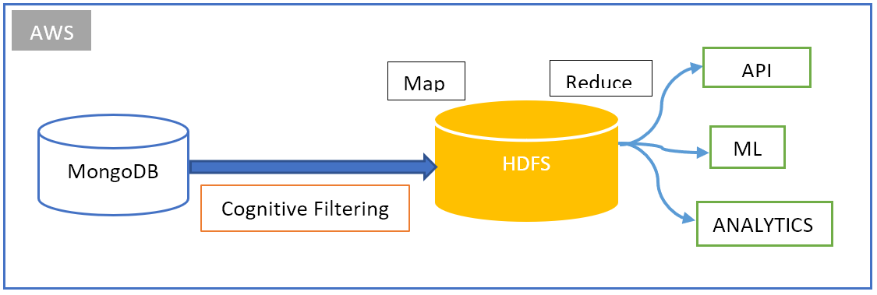
Cognitive Filtering
The tweet output is mixture of different context.
For example, taking flooding as a keyword to filter and store data, the system can have information such as "flooding in my bathroom" or "flash flooding in the street" can mean very differently and the system is not capable of recognizing these differences.
A cognitive filtering system can help in providing a solution.

Slide 22
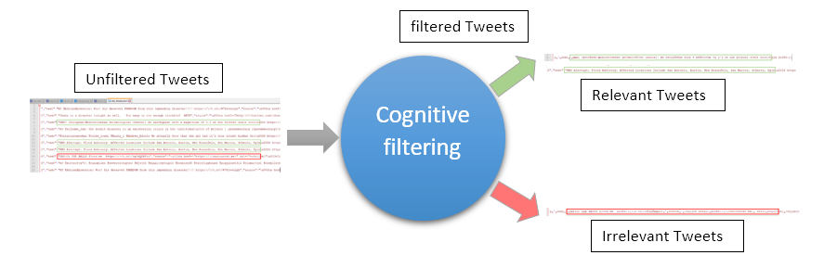
How does it work?
Cognitive filtering model works to filter the tweets base on relevance of the information being fed to it.
The model is trained to understand the context of the data and provide output based on those requirements.
With respect to filtering the disaster related data, the model takes the unfiltered data and filters the data into relevant and irrelevant information.
The relevant information is sent to the Hadoop data store for further processing, the irrelevant information is discarded, saving space.

Slide 23
Hadoop and AWS
The filtered tweets are the input for the Hadoop datastore.
01
The relevant tweets are sent to be processed using Hadoop map and reduce to produce a location-based result.
02
The platform is setup on Amazon EC2 making the platform resilient to disaster impact.
03

Slide 24
Contributions
The focus in this study

Slide 25
Objectives Achieved
Information is gathered from Twitter, demonstrating social media sources as a trove of information.
Cloud computing and NoSQL are successfully used to store disaster-related Big Data.
These choices make the system more resilient. Key Words being HA, Fault Tolerance, Replication.
The data provided is in raw format making it easier to do search, data delivery and integration.

Slide 26
What’s next?
Future work

Slide 27
Some ideas to work with
Creating a Web Application to interface with the system.
1
Creating native applications for individual platforms.
2
Context filtering model.
3
Compare the other NoSQL data store to check for obvious performance benefits.
4
Check the space requirements and find ways to reduce data storage, remember its Big Disaster-Related Data.
5
Check for information conflict.
6
Verify Data at the Sources.
7
Avoid Redundancy.
8
Also, need to focus on privacy and security.
9

Slide 28
Thank you.
☺

